Slide 1

CRYPTO TRADING ROBOT
by iñigo Larrea pombo

Slide 2
Tech Requirements
Network
Satellite
Link

Slide 3

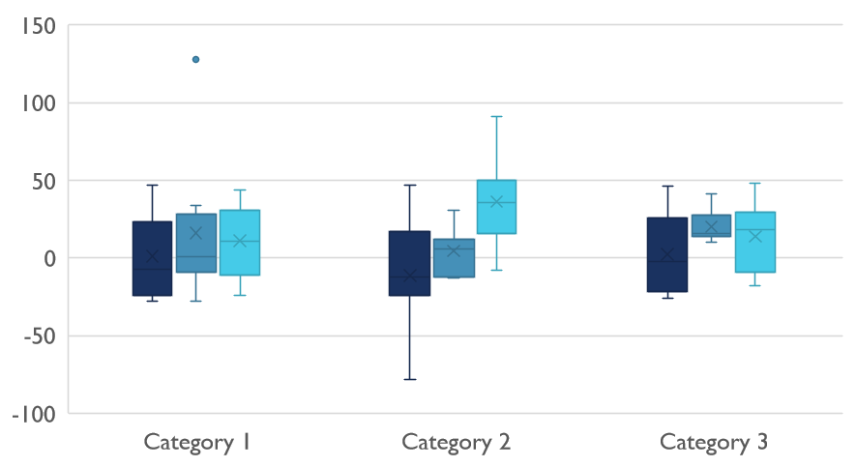
Competitive Landscape

Slide 4

Digital Communications
Cloud
Local
Hybrid

Slide 5

Thank You
pombo7676@gmail.com

